Slide 1
OBJECT IDENTIFICATION AND TRACKING
Computer Vision based
By Abhinav Jain
Project Supervisor-
Prof. Nischal K. Verma

Slide 2
Approaches to track objects (2015)
Optical Flow Approach
Background Subtraction
Interest Point Tracking
Real-Time Compressive Tracking-based on extracted features
Extended Kanade-Lucas Tracker

Slide 3
Common Issues Faced By Tracking Algorithms
Pose changes
Illumination change
Scale Change
Occlusion
In and Off planar rotations
Drift problem for template matching learning algorithms

Slide 4

Some Points To Note
For the coding purpose, we have used MATLAB as a platform for its simplicity as compared to other programming languages. For every method, to specify the object to be tracked, we’ll use a selection window to select the object and MATLAB will give the centroid of the selection window and will keep updating it.

Slide 5
1. Optical Flow approach
Optical flow is the pattern of apparent motion of objects, surfaces, and edges in a visual scene caused by the relative motion between an observer (an eye or a camera) and the scene
Solving of transcendental equations is required
Calculation is both complex and extremely sensitive to noise
Real-time performance and the practicability is poor
Difficult to be used in real-time video processing

Slide 6
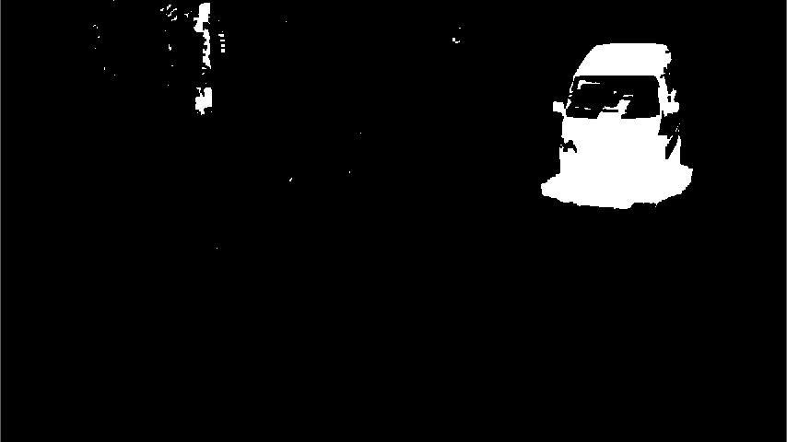
2. Background Subtraction
Involves a model (Gaussian mixture model) to train a classifier that separates the foreground from background
Uses blob analysis to classify objects based on the no. of pixels they occupy.
Uses Kalman Filter for tracking

Slide 7
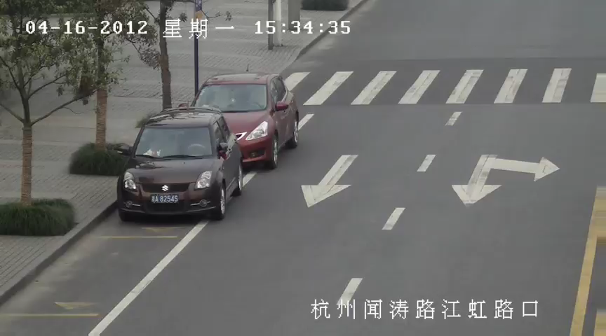
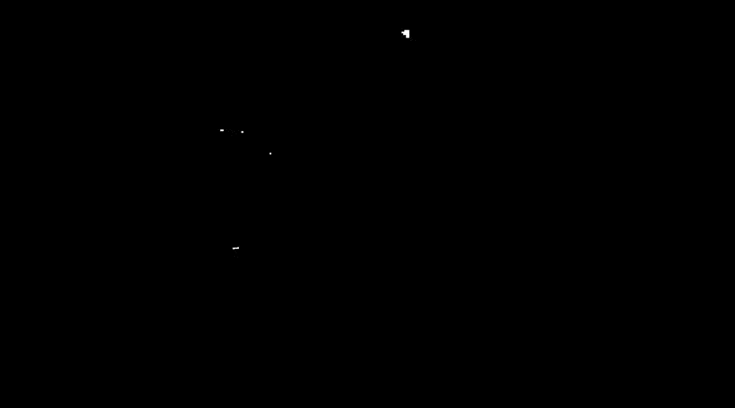
Background Subtraction in action
Original Video
Processed (Binary) Video

Slide 8
Background Subtraction
Pros | Cons
Allows occlusion (uses Kalman filter) | Requires stationary camera
Rotations allowed | Prior knowledge of threshold required for blob analysis
 | Sensitive to illumination and external conditions.

Slide 9
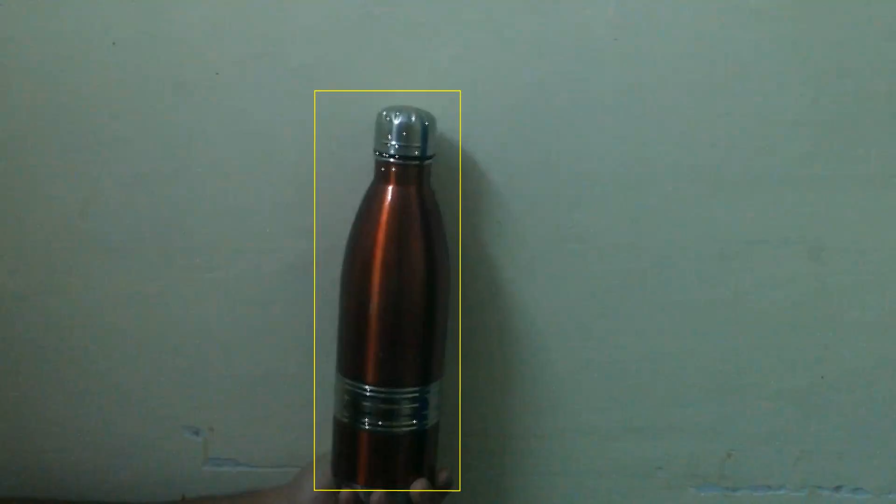
3. Interest Point Tracking
Interest Points are points at which direction of boundary of object changes abruptly.
There are various interest point detectors like Harris, SURF, SIFT etc.
Interest points are tracked in consecutive frames using KLT tracking algorithm
Yellow Box shows object of interest

Slide 10
Interest Point Detectors Comparison
Interest point detectors | Pros | Cons
Harris Corner Detector | Planar Rotation Invariance Excellent Repeatability Rate for Affine Transformation | Computationally Demanding Sensitive to Noise Not invariant to Scale
SIFT (Scale Invariant Feature Transform) | Scale Invariant Works well in variable lighting conditions Uses local feature descriptors so is not affected by occlusion | Computationally Demanding Works badly in poor resolution frames
SURF (Speeded Up Robust Features) | Much faster Computation

Slide 11
Why not Interest Point Tracking ?....
We avoided using this method in general, since it requires repeated computation of interest points every time they decreases
It can’t handle non-planar rotations.

Slide 12
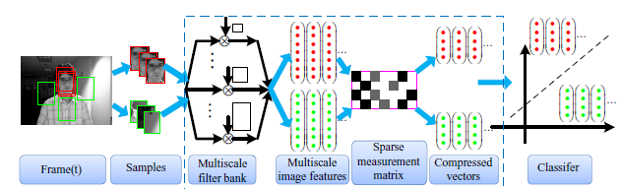
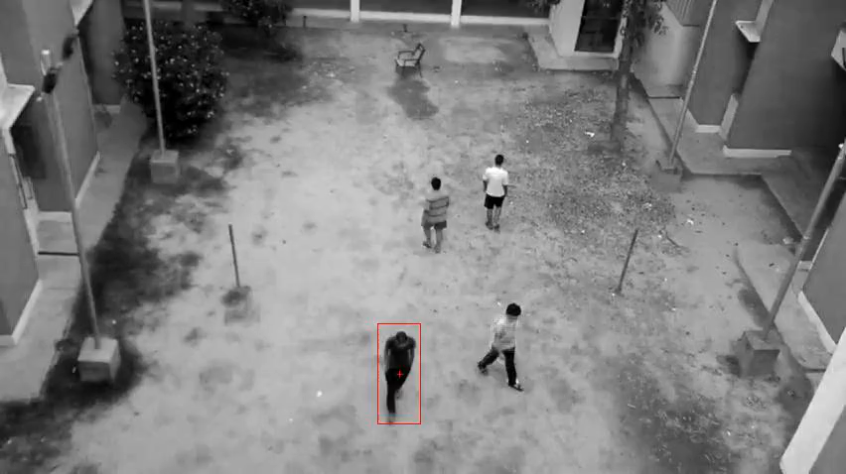
4. Real-Time Compressive Tracking
an appearance model based on features extracted in the compressed domain.
Features are selected based on compressive sensing theories which uses a sparse measurement matrix.
For tracking, the positive and negative samples are compressed with the same sparse measurement matrix and discriminated by a simple naive Bayes classifier learned online.

Slide 13
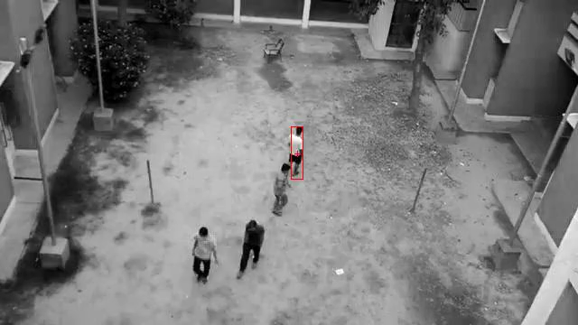
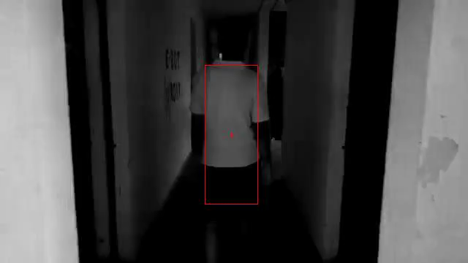
Some other simulations

Slide 14
Real-Time Compressive Tracking
Factors judging fps:
Quality of video : higher quality video requires more compilation time
Processing speed of host computer : judges the compilation time of Matlab
Factors judging the quality of tracking:
Adjustable parameters
Size of the window to select the target
Area of the window grazed by the target
Advantage | Disadvantage
Easily handles illumination and pose changes | Fails to track if complete occlusion takes place or tracking window is grazed by objects other then the target.

Slide 15
5. Extended Kanade-Lucas tracking Algorithm
The famous Lucas-Kanade (LK) performs template based matching and tracking
One of the problems arising when using target templates, bounded by a rectangle, is the inclusion of background pixels in the target image. When matching the template, one is also required to match the included background pixels which can ultimately lead to drift.
Extended KLT algorithm extends the original one to account for pixels object / background likelihood.
Also it is equipped with a simple occlusion handling logic.

Slide 16
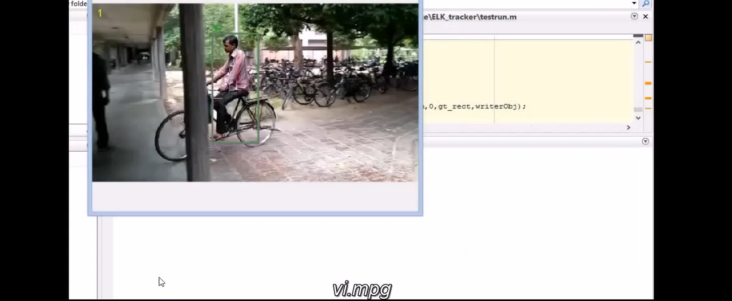
The following video shows implementation of extended Kanade-Lucas tracking algorithm which effectively copes up with occlusion, pose changes, illumination and scale changes

Slide 17
We ‘ll use Extended Kanade-Lucas Method for tracking because of its robustness, effectiveness and accuracy.
Conclusion
Future Work
Will work on award working tracking algorithm Extended Kanade-Lucas which will involve proper tuning of various parameters involved in the code for tracking with UAVs.

Slide 18

Thank You !!...

